Slide 1
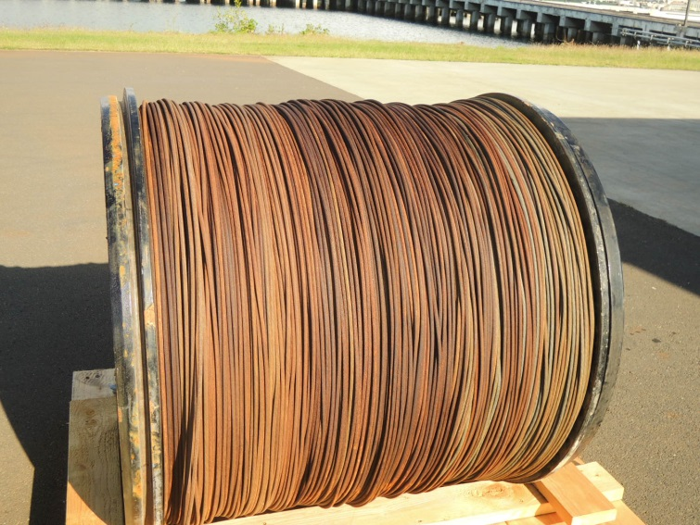
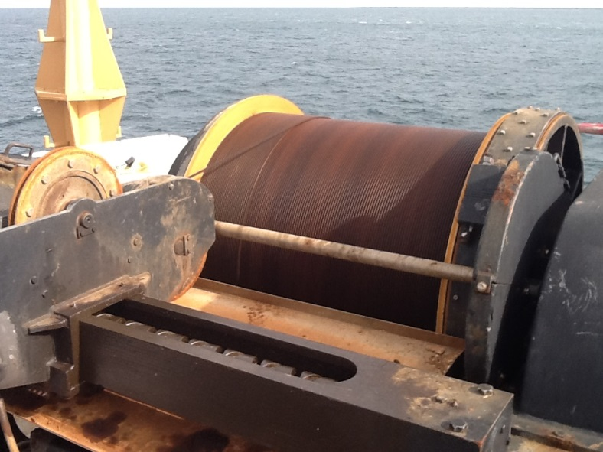
CTD Cable Issues
NOAA Ship Ronald H Brown FY16 Users Meeting
October 14, 2015
(Aft) Cable removed Dec 2014
(Aft) Present Cable Sep 2015
Electromechanical Cable Lubing Procedures Strategies

Slide 2
Topics to Cover
NOAA Ship Ronald H Brown FY16 Users Meeting
October 14, 2015
Recent History of RB CTD cables – Kamphaus
Rapid deterioration of wires – Kamphaus
Updated lubrication procedures – Kamphaus / Larson
UNOLS Appendix A (Brief overview) – Larson
Strategies going forward - All

Slide 3
Recent History of RB CTD cables
May 2010 – CASREP 2010-08 – (1) AFT Markey CTD 0.375 EM cable – improperly wrapped deep spool, cross-wrapped and crushed wire and (2) severe vibration under load.
Aug 2010 – electrical system adjustments to correct vibration.
Mar 2011 – CASCOR 2010-08 – drum replaced with 0.322 EM cable, new Lebus shell
Cost to correct: $58,460

Slide 4
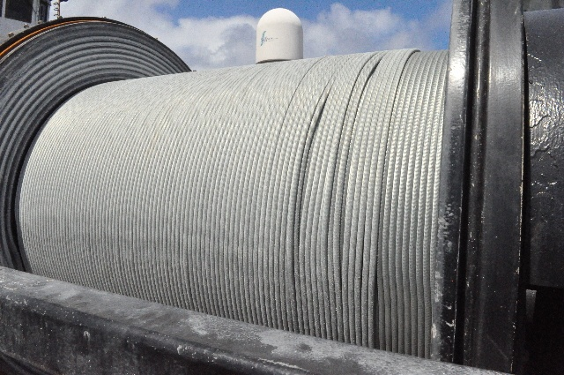
CASREP 2010-08 AFT 0.375 wire

Slide 5
Recent History of RB CTD cables
FWD Winch 0.322 EM cable strands break
04 APR 2010 – strand breaks at 4000m wire out
10 MAY 2010 – second strand breaks at 1348 m
May 2010 – CASREP 2010-09 – 0.322 EM cable failed in two places; limit CTD to 1300 m
Sep 2010 – cable replaced with fleet spare 7800m of 0.322
Cost to correct: $47,300

Slide 6
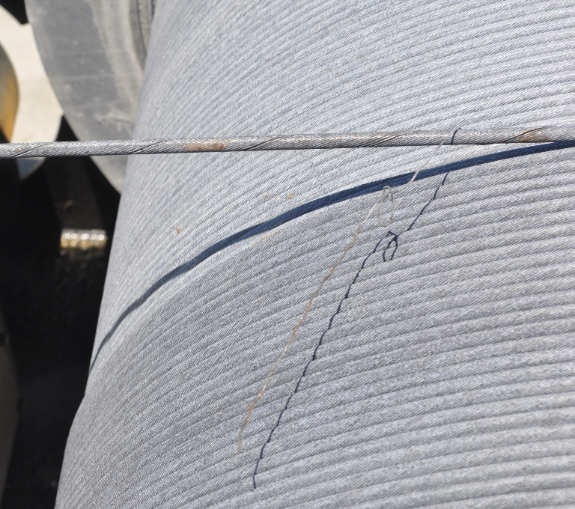
CASREP 2010-09 FWD 0.322 wire

Slide 7
Recent History of RB CTD cables
Oct 2011 – CASREP – 2011-04:
FWD CTD winch (fleet spare 0.322 wire) spools incorrectly and (2) AFT CTD winch (new 0.322 wire) [still] has severe vibration
First deep cast on FWD wire to 5000m revealed major wrapping problems on both ends of spool
AFT winch severe vibration under heavy load deeper than 3500 m
Nov 2011 - AFT winch failed; tachometer/generator sheared coupling and shaft
Nov 2011 - AFT winch shaft and coupling repaired by Markey.
New wire requested; assumed to be replaced in early 2012.

Slide 8
Recent History of RB CTD cables
2012 – No CASREPs for CTD winches or cable.

Slide 9
Recent History of RB CTD cables
2013 – Sep 2013 – CASREP 2013-08 – AFT winch not spooling correctly during A16S; switch to FWD CTD and cable parted
FWD cable parted at ~3000m deep; had not been used in ~18 months; cable had ~60 casts on it; deepest was 5500m.
Ship investigation report completed – improper lubrication
PMEL sponsored forensic analysis – stray current / electrolysis
Sep 2013 – re-spooled AFT winch at sea in order to finish project
Oct 2013 – AFT cable visible deterioration, cut 3000 m off; showing “continuing and progressively worsening deterioration and corrosion despite recent lubing.”
Nov 2013 – Corrosion noted throughout interior strands; additional 1200m wire cut and discarded. 5500m wire remains.

Slide 10
Recent History of RB CTD cables
CASREP 2013-08 (Cont)
December 2013 – two new spools of cable (one 0.375 and one 0.322 from UNOLS) received and installed in Recife, Brazil.
May 2014 – 0.375 “backup” cable (FWD) removed and shipped to MOC-P as fleet spare.
July 2014 – new 0.322 “backup” (FWD) cable installed
Sep 2014 – Markey Tech Rep visited ship to inspect winch installations for stray current; proper grounding noted.
Costs to repair: $208,000 (does not include replacement cost of lost instruments)

Slide 11
Recent History of RB CTD cables
CASREP 2014-10 – AFT CTD cable not spooling correctly. “New wire installed in Dec 2013… no issues or adjusts for a couple hundred deep casts through April 2014.”
Sep 2014 - Adjusted level wind on first deep cast on TAO project
Oct 2014 – Adjusted a couple more times on deep casts.
Nov 2014 – numerous level-wind adjustments required from 2200m depth to surface; switched to forward winch.
Nov 2014 – sheave close to drum was loose; bearing and bushings replaced; unable to test repairs
Dec 2014 – cable spooled off for lubricating, but found to be severely corroded. Source of new CASREP.

Slide 12
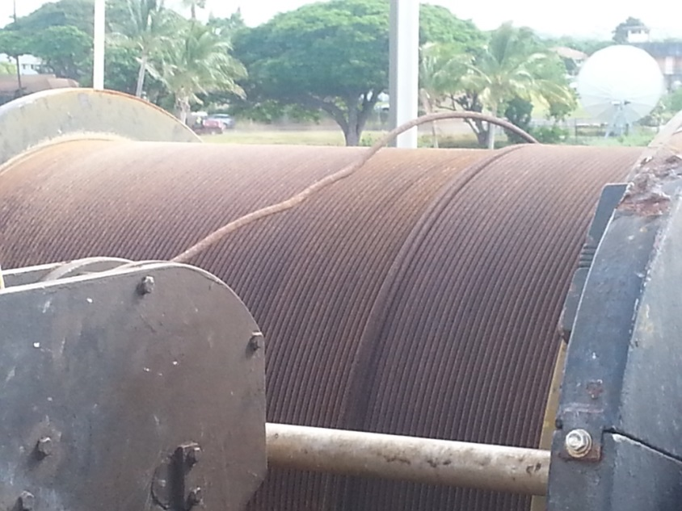
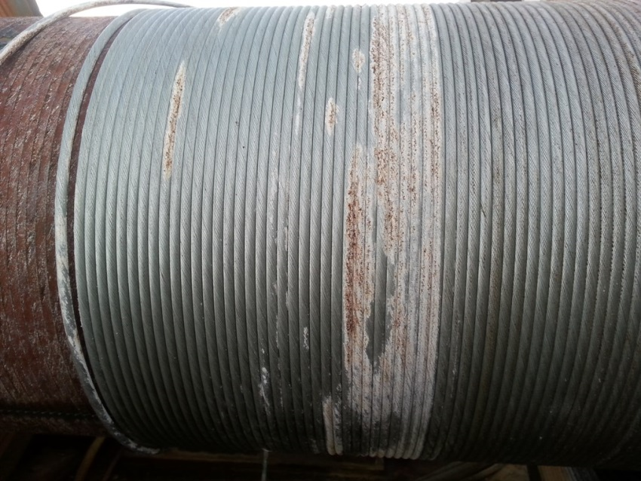
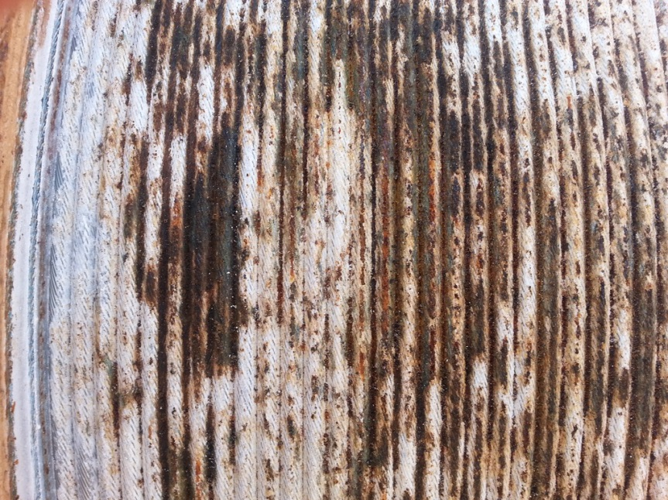
Recent History of RB CTD cables
4000m
9000m
AFT 0.322 wire – Dec 2014 –6500m

Slide 13
Recent History of RB CTD cables
Dec 2014 - CASREP 2014-12 – AFT CTD cable spooled off for lubrication; cable unusable due to corrosion and discarded.
Feb 2015 – new 0.322 cable from UNOLS wire pool shipped to Markey. Spooled on under tension and lubricate using Stran-Core and portable Core-Lube device.
Late Feb 2015 – new drum and cable installed on AFT winch in San Diego, CA
Cost $72,500

Slide 14
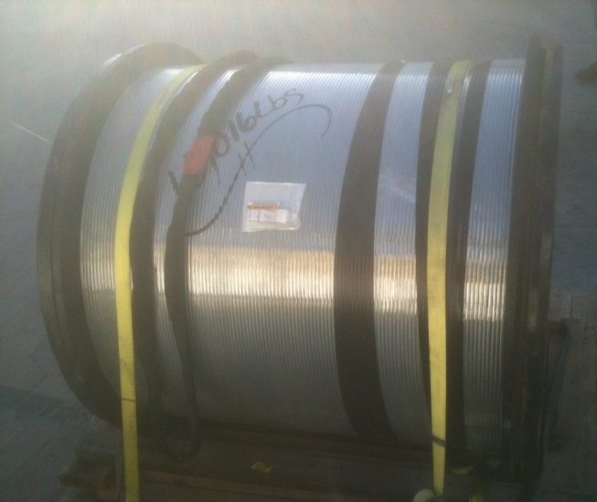
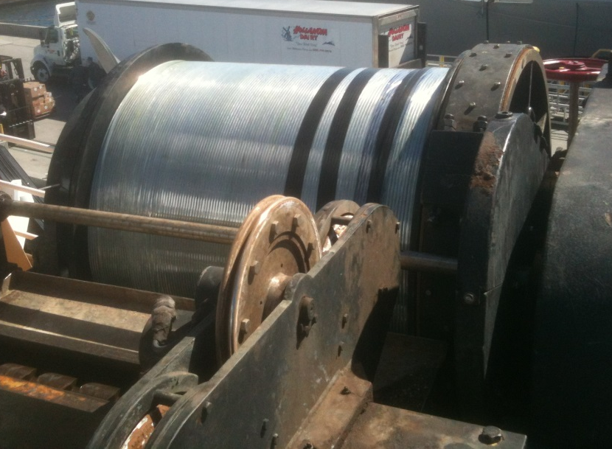
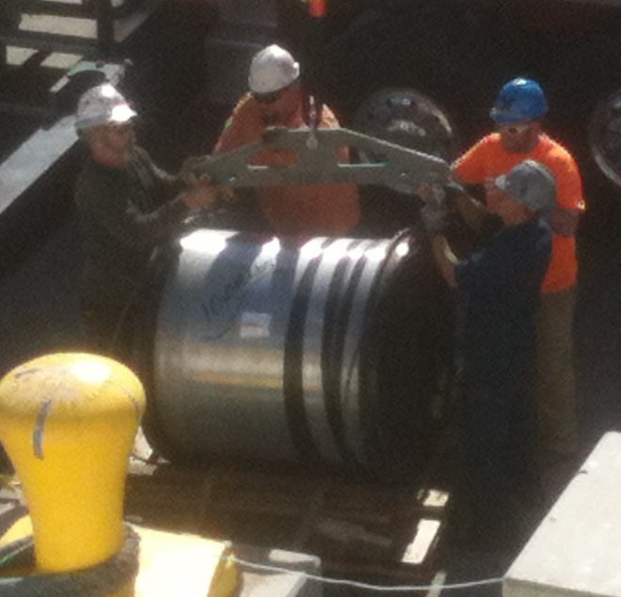
Recent History of RB CTD cables
New wire loaded aboard AFT Winch – Feb 2015

Slide 15
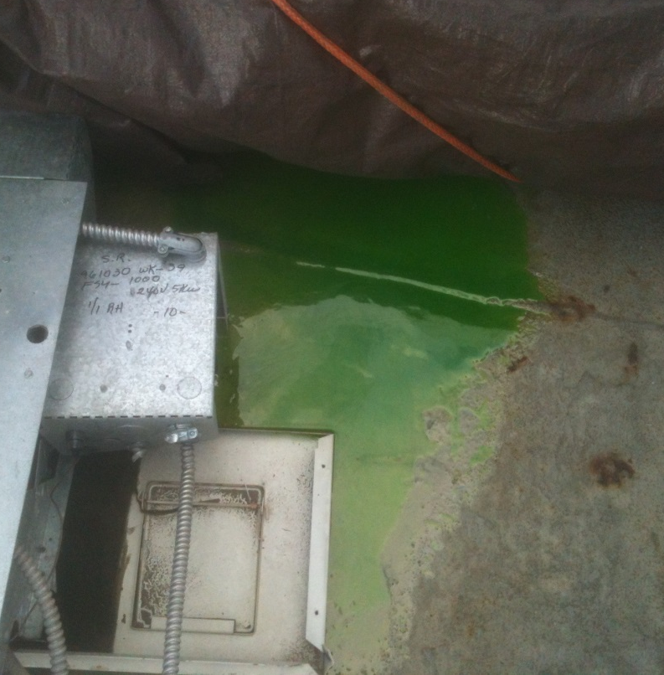
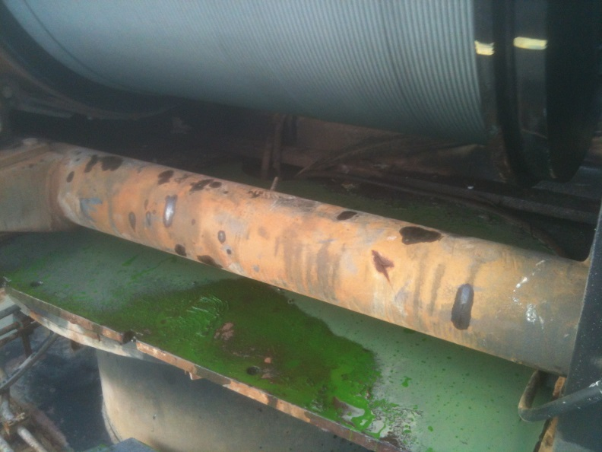
Recent History of RB CTD cables
Wire came well lubricated

Slide 16
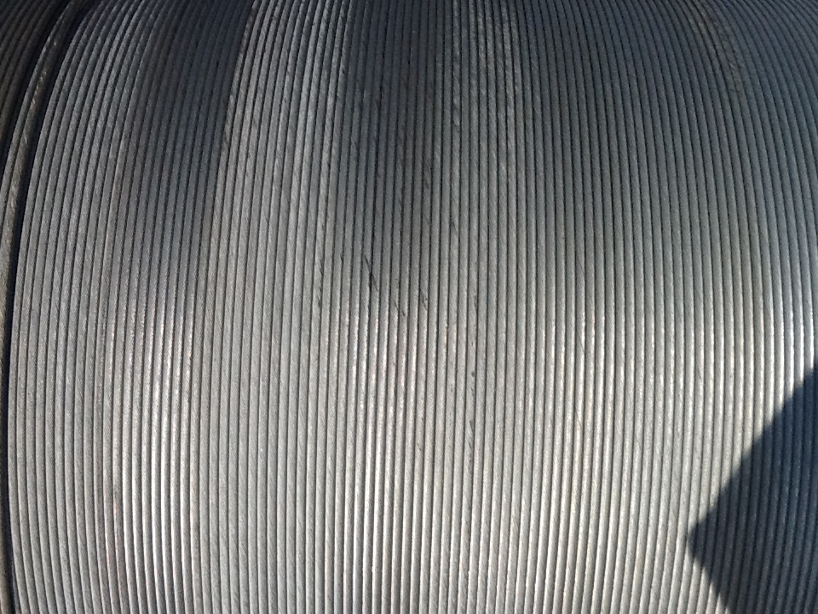
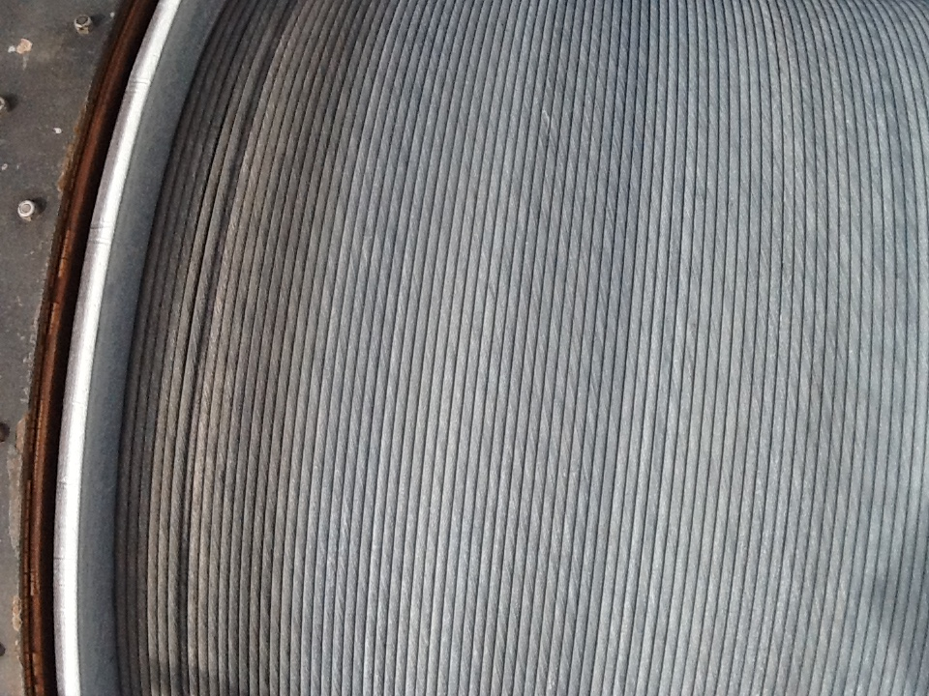
Deterioration of Cable
CLIVAR Leg 1 (10 April – 12 May; Stations 001-112)
After CTD station #10 (10 deep casts)
13 APR 2015
After CTD station #65
27 APR 2015

Slide 17
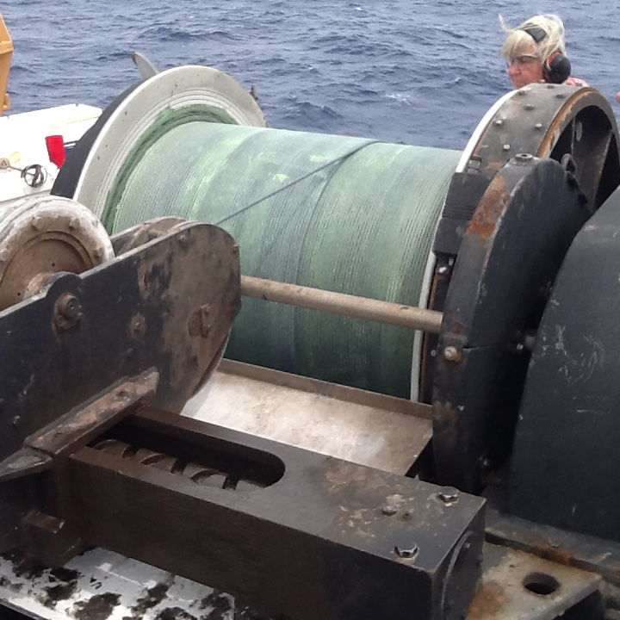
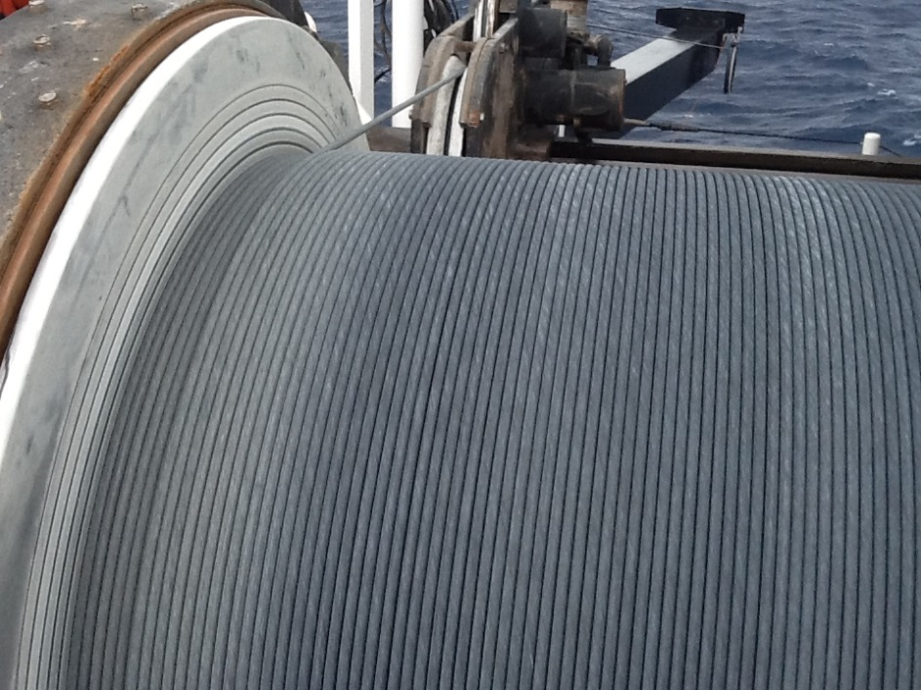
Deterioration of Cable
CLIVAR Leg 1
CTD station #94 – before lubrication
5 May 2015
CTD station #94 – after lubrication
5 May 2015

Slide 18
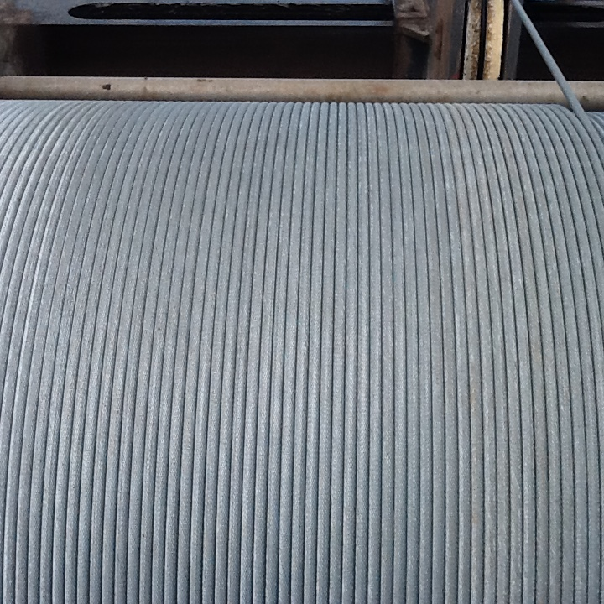
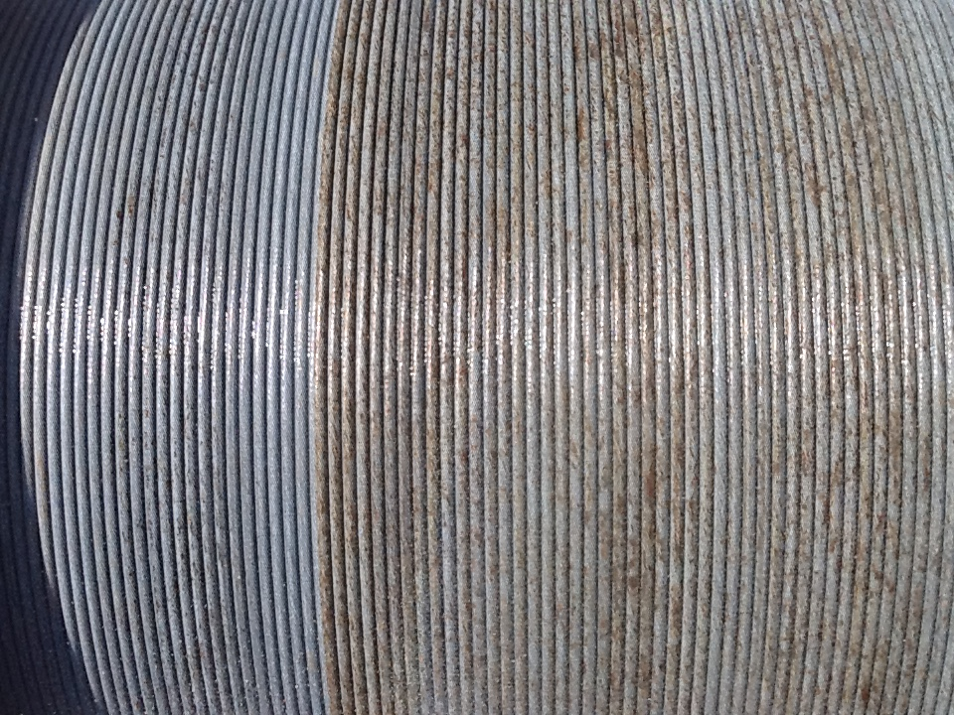
Deterioration of Cable
CLIVAR Leg 2 (25 May – 27 June; Stations 113-207)
CTD station #115 – at depth – 5383m
27 May 2015
CTD station #115 – 4547 m
27 May 2015

Slide 19
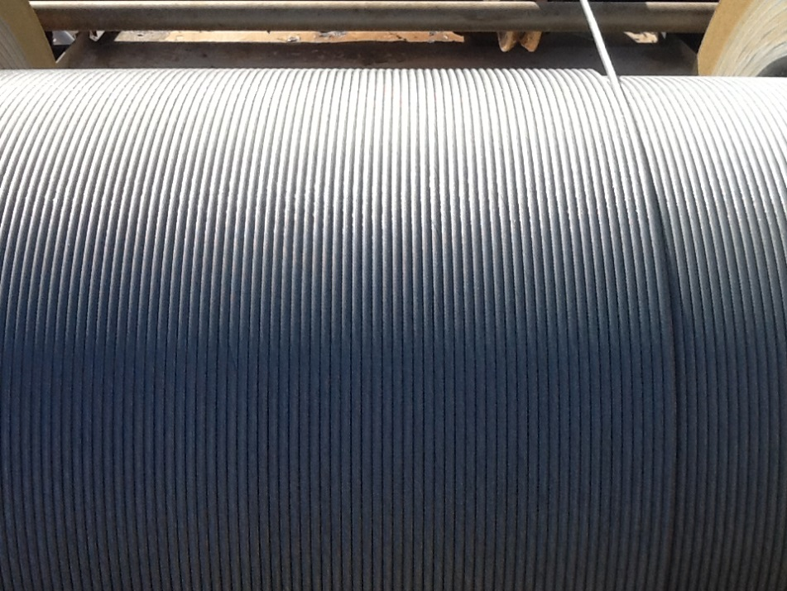
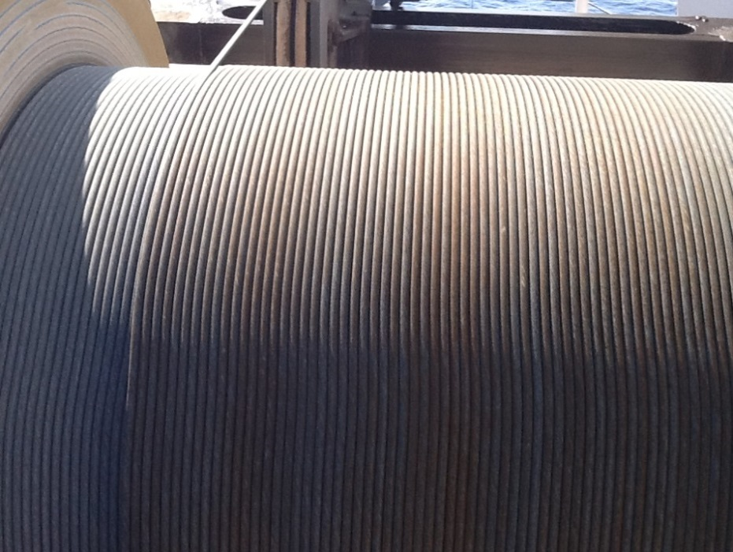
Deterioration of Cable
CLIVAR Leg 2 (25 May – 27 June; Stations 113-207)
CTD station #141 – at depth –5927m
4 June 2015
CTD station #141 – 4518 m
4 June 2015

Slide 20
Deterioration of Cable
CLIVAR Leg 2 (25 May – 27 June; Stations 113-207)
CTD station #141 – at depth –5927m
4 June 2015
CTD station #141 – 4518 m
4 June 2015

Slide 21
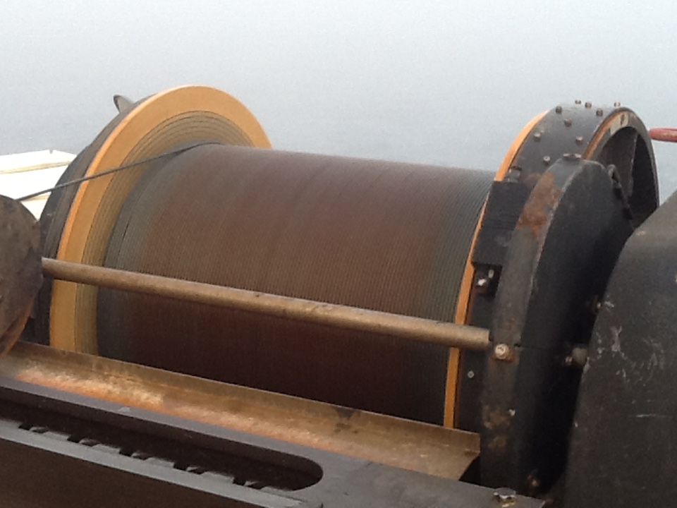
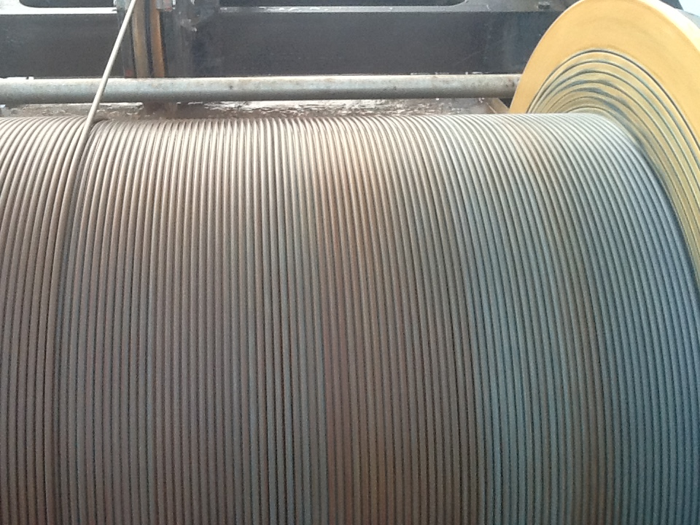
Deterioration of Cable
CLIVAR Leg 2 (25 May – 27 June; Stations 113-207)
CTD station #181 – 4335m
16 June 2015
CTD station #181 – ~4000m
16 June 2015

Slide 22
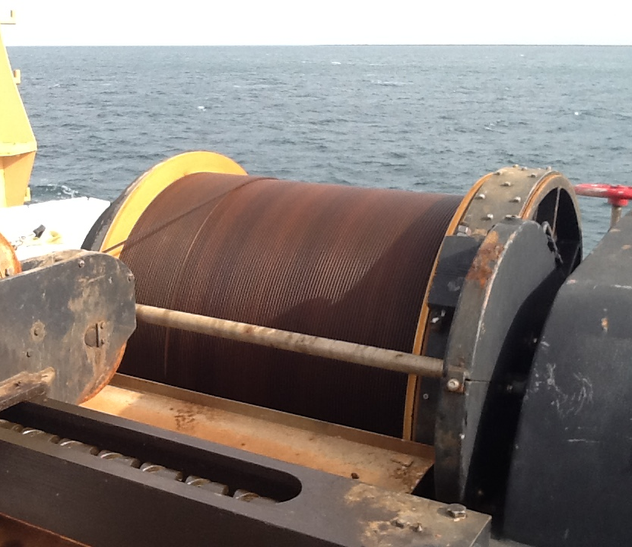
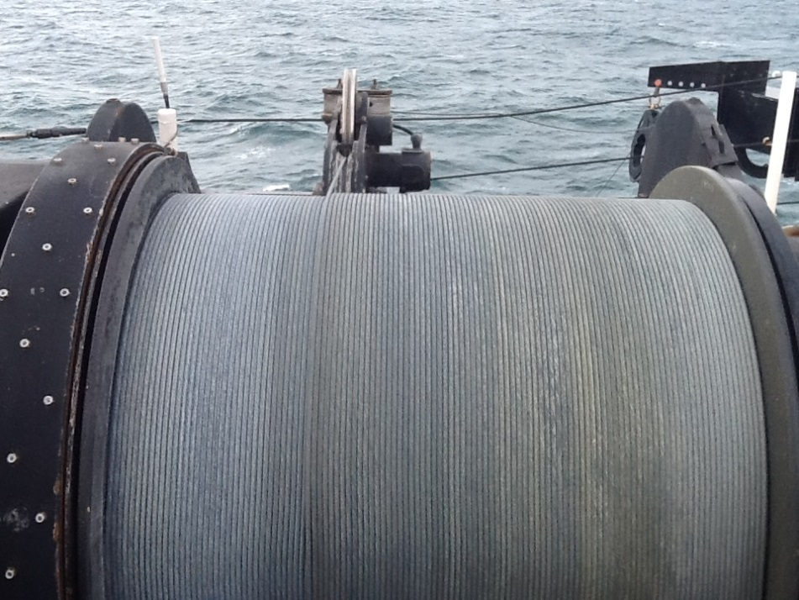
Present condition of cables
AFT winch and cable
~ 360 casts; 200 + full ocean depth
Cable installed Feb 2015 in San Diego
Lubricated with Stran Core at delivery and 2 more times (CLIVAR Leg1, Leg 2)
FWD winch and cable
~175 casts; mostly shallow;
100 very shallow in Arctic
Cable installed July 2014
Lubricated with Pre-Lube 19, once at end of TAO (Mar 2015)

Slide 23
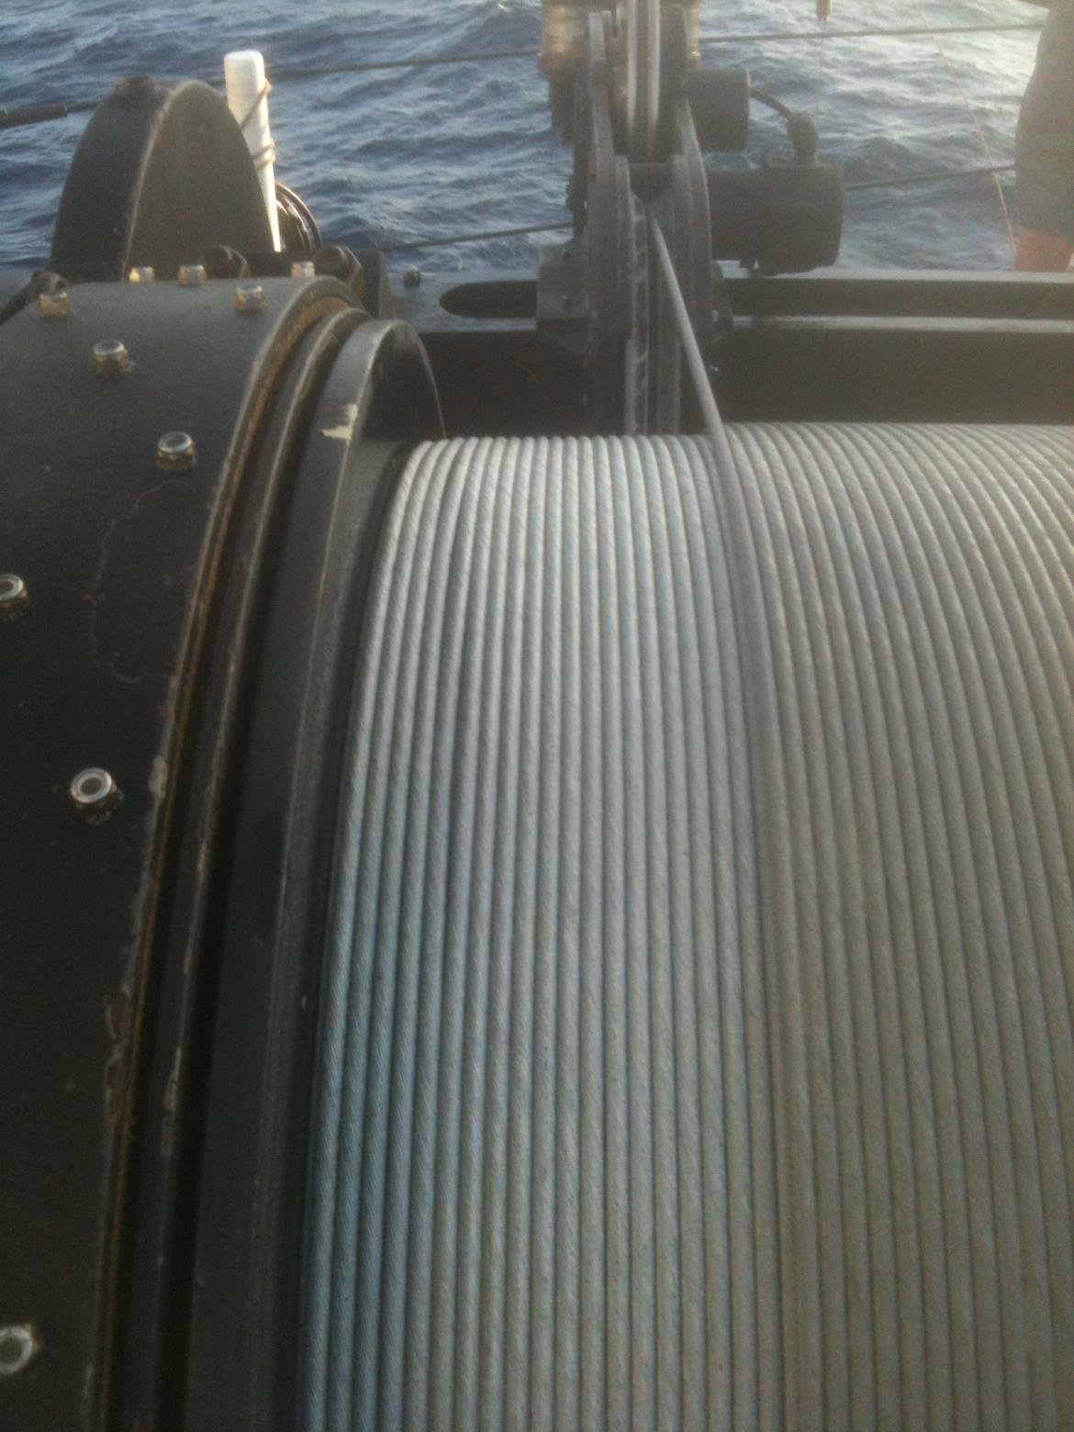
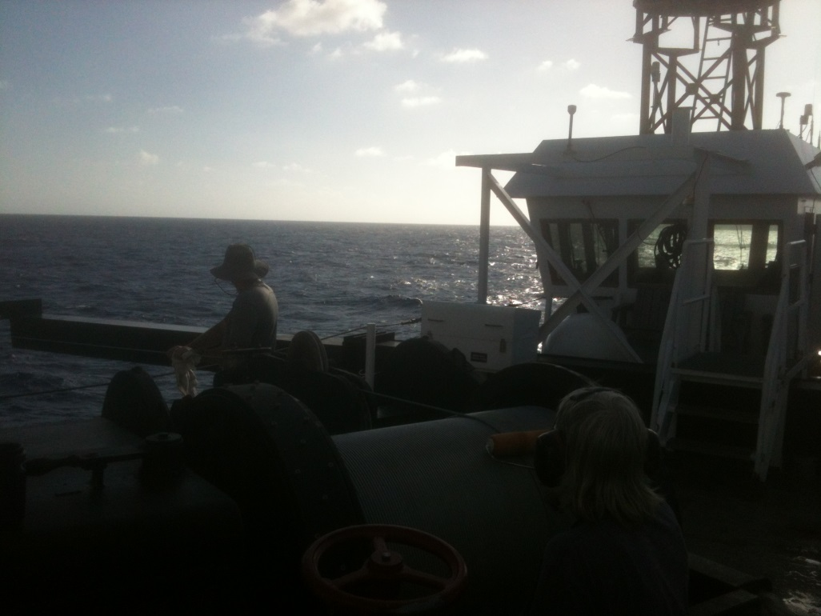
Cable Lubrication - Old

Slide 24
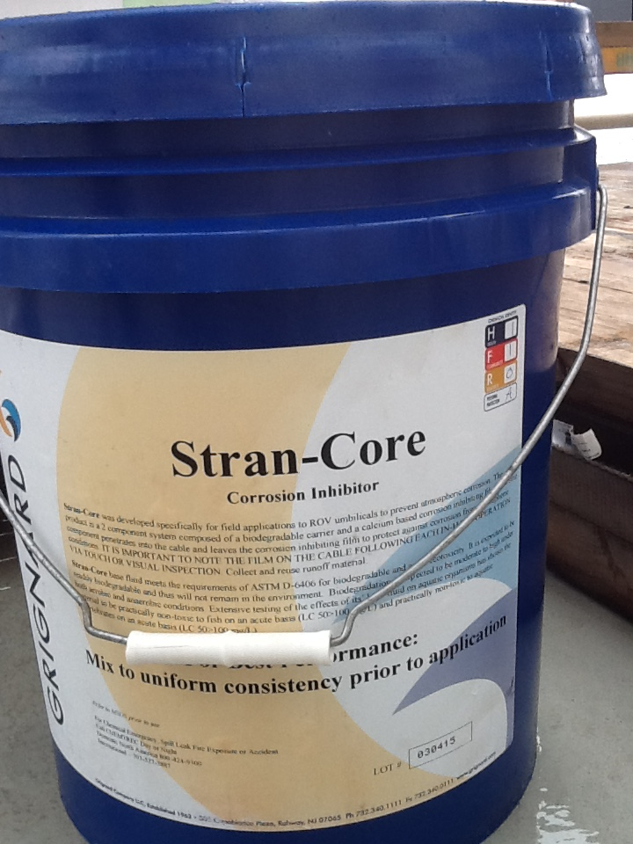
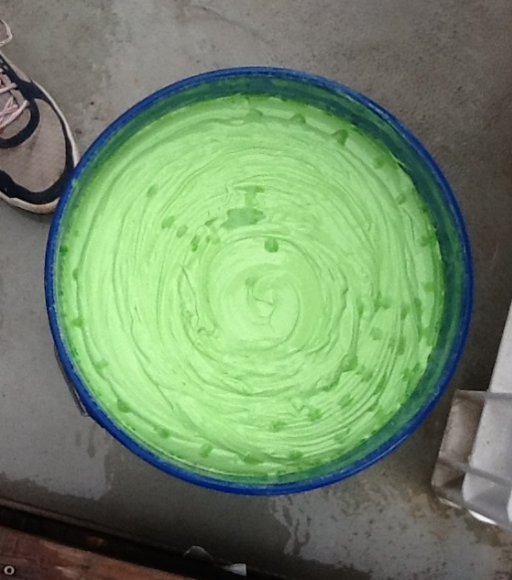
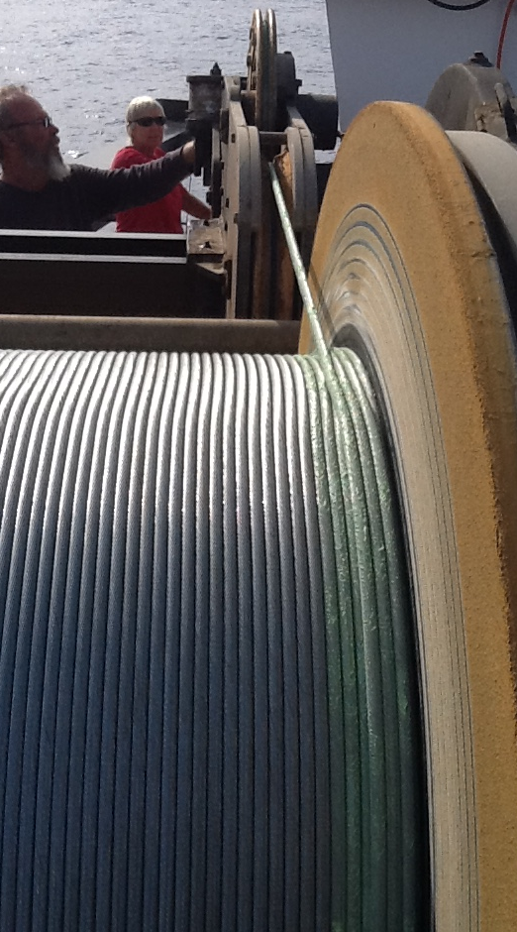
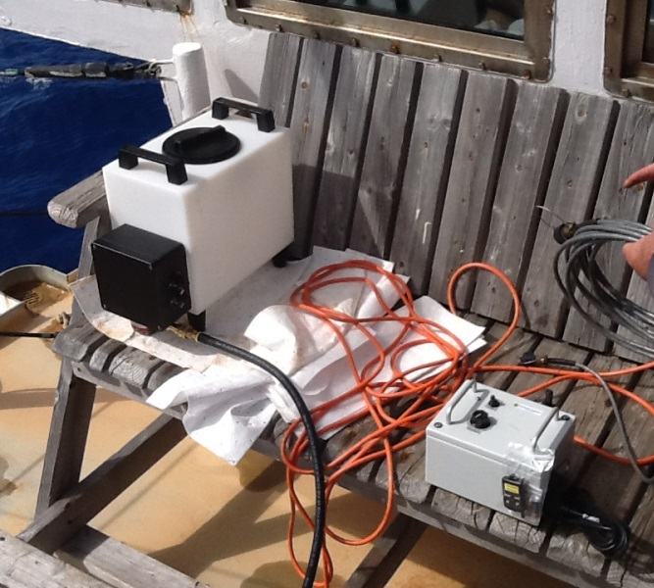
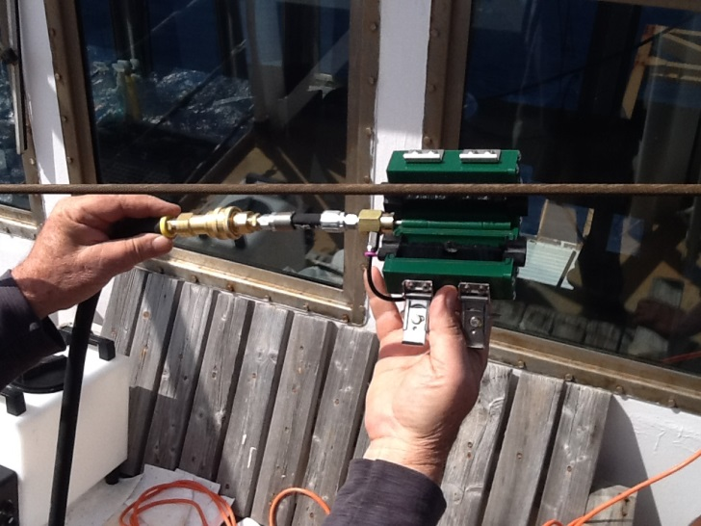
Cable Lubrication - New

